Slide 1
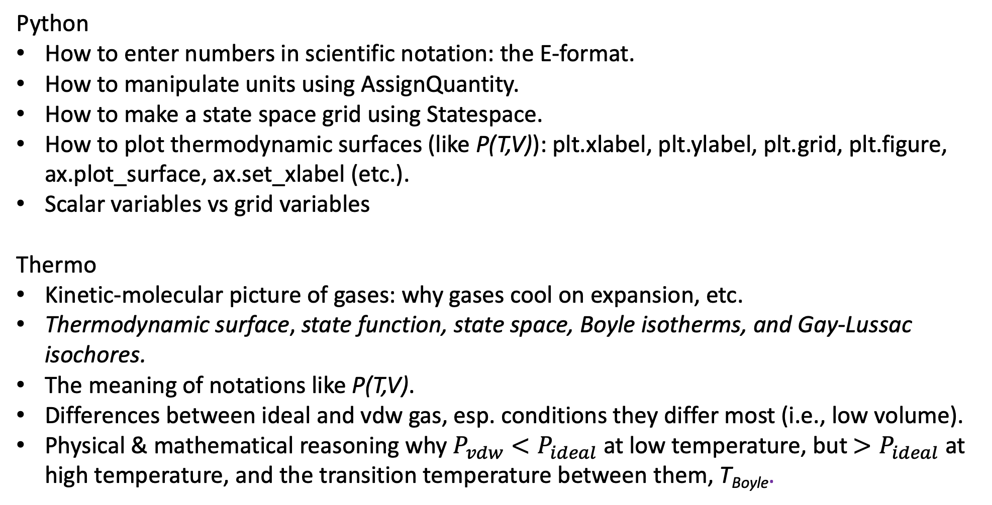
What we’ve learned …
Python
How to enter numbers in scientific notation: the E-format.
How to manipulate units using AssignQuantity.
How to make a state space grid using Statespace.
How to plot thermodynamic surfaces (like P(T,V)): plt.xlabel, plt.ylabel, plt.grid, plt.figure, ax.plot_surface, ax.set_xlabel (etc.).
Scalar variables vs grid variables
Thermo
Kinetic-molecular picture of gases: why gases cool on expansion, etc.
Thermodynamic surface, state function, state space, Boyle isotherms, and Gay-Lussac isochores.
The meaning of notations like P(T,V).
Differences between ideal and vdw gas, esp. conditions they differ most (i.e., low volume).
Physical & mathematical reasoning why $P_{vdw}<P_{ideal}$ at low temperature, but $>P_{ideal}$ at high temperature, and the transition temperature between them, T_{Boyle}.

Slide 2
Scalar variables vs grid variables
A scalar = a single number, like a volume or temperature
V
T
A grid = rows and columns of numbers (here, T,V state space)
In our Python code so far, we’ve generally used this naming convention
V, T, P to refer to scalars
Vgrid, Tgrid, Pgrid to refer to grids (often made by PL.Statespace)
(This naming convention is violated all the time, by the way, so you need to pay attention to how these are created to really know the difference.)

Slide 3
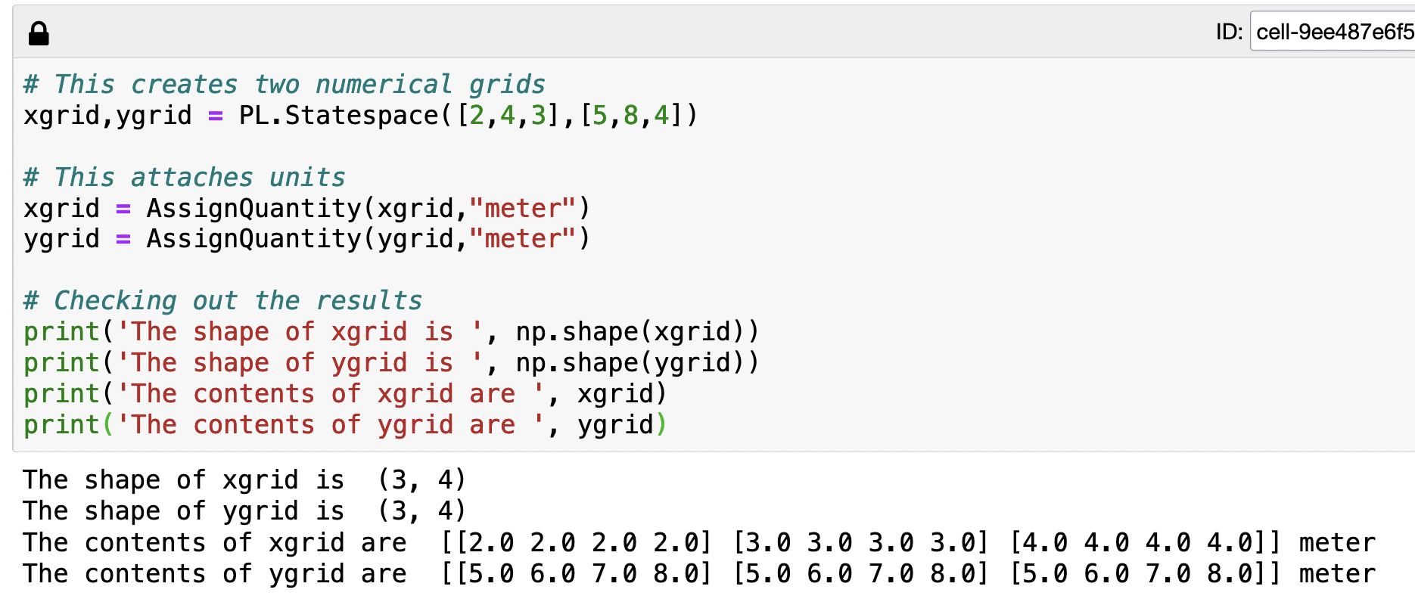
One way to make a gridded variable: use PL.Statespace
2.0 2.0 2.0 2.0
3.0 3.0 3.0 3.0
4.0 4.0 4.0 4.0
5.0 6.0 7.0 8.0
5.0 6.0 7.0 8.0
5.0 6.0 7.0 8.0
Both grids have “shape” 3x4
(3 rows and 4 columns)
This controls x-grid
This controls y-grid

Slide 4
One way to make a gridded variable: use PL.Statespace
2.0 2.0 2.0 2.0
3.0 3.0 3.0 3.0
4.0 4.0 4.0 4.0
5.0 6.0 7.0 8.0
5.0 6.0 7.0 8.0
5.0 6.0 7.0 8.0
Both grids have “shape” 3x4
(3 rows and 4 columns)

Slide 5
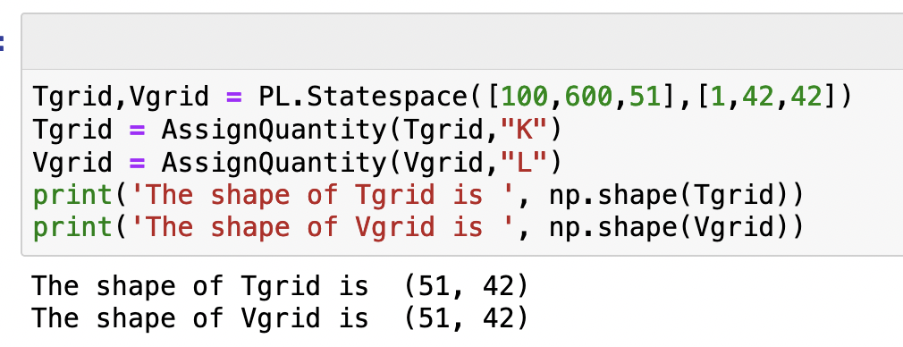
What would appear when we run this code?

Slide 6
What would appear when we run this code?

Slide 7
What would appear when we run this code?
42 volumes (columns)
V
T
51 temperatures (rows)

Slide 8
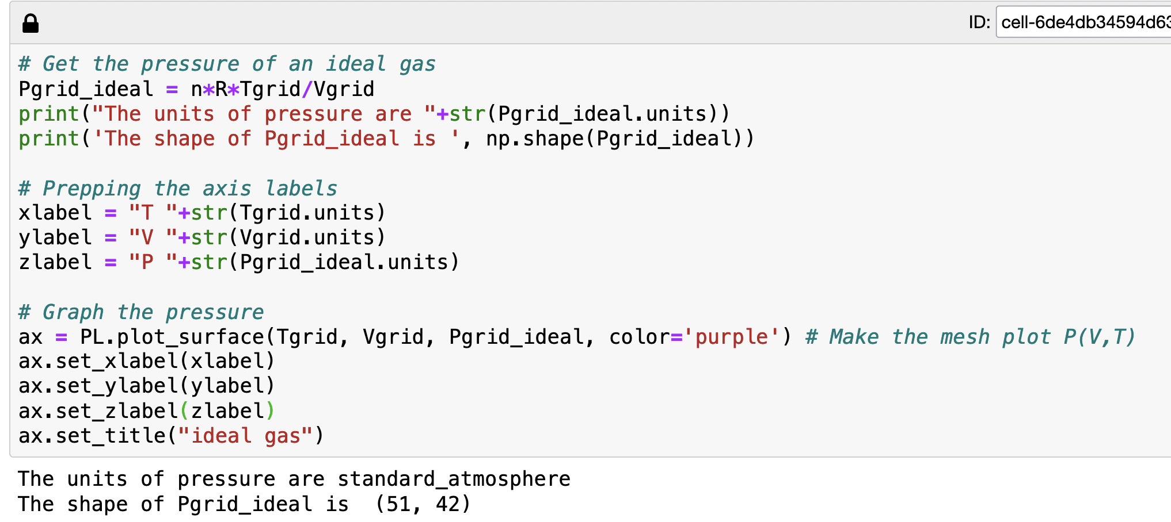
Another way to make a gridded variable: Calculate something from gridded variables (!)

Slide 9
Another way to make a gridded variable: Calculate something from gridded variables (!)
For every combination of volume and temperature, calculate a pressure.

Slide 10
Another way to make a gridded variable: Calculate something from gridded variables (!)
42 volumes
V
For every combination of volume and temperature, calculate a pressure.
T
51 temperatures

Slide 11
Another way to make a gridded variable: Calculate something from gridded variables (!)
42 volumes
V
For every combination of volume and temperature, calculate a pressure. So Pgrid_ideal is also a gridded variable!
T
51 temperatures

Slide 12
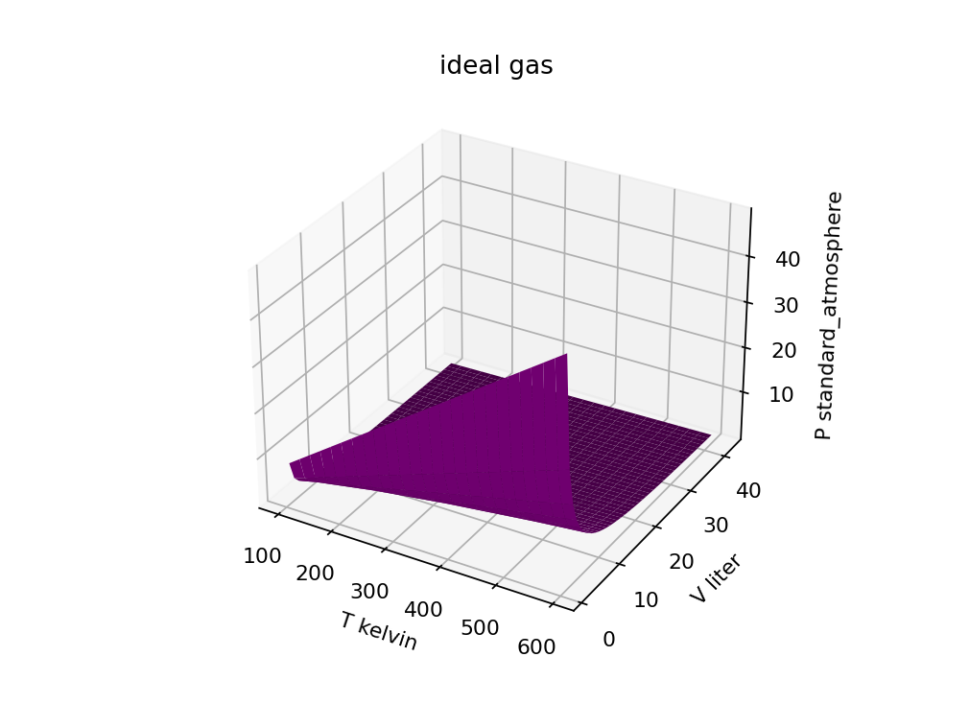
Visualizing a calculated gridded variable
42 volumes
51 temperatures

Slide 13
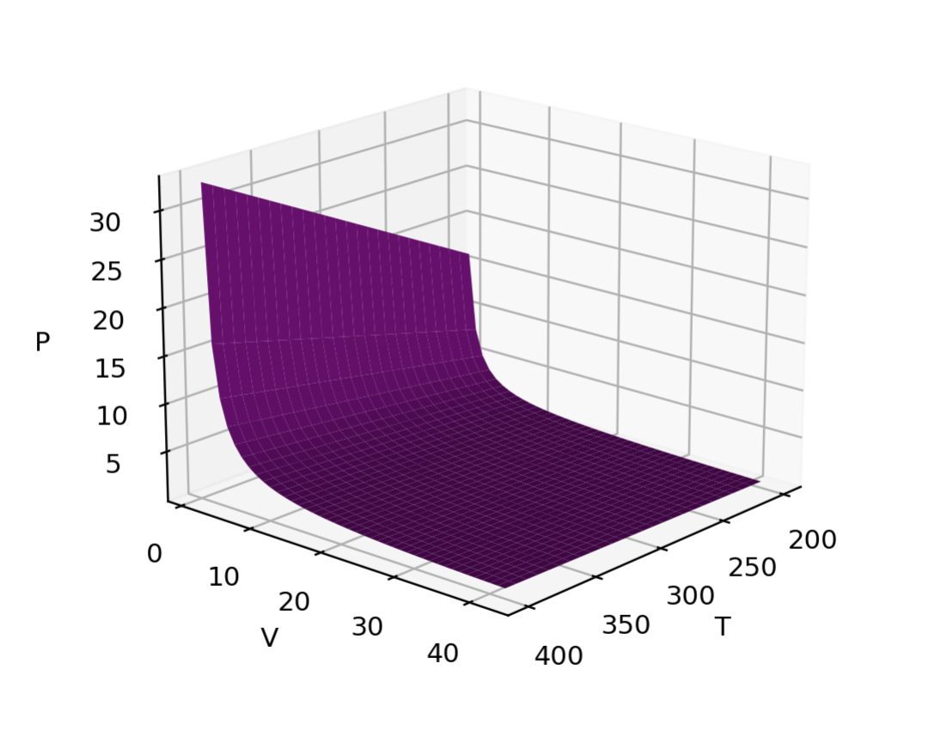
Isotherms and isochores
Isotherm = path of constant temperature
Isochore = path of constant volume

Slide 14
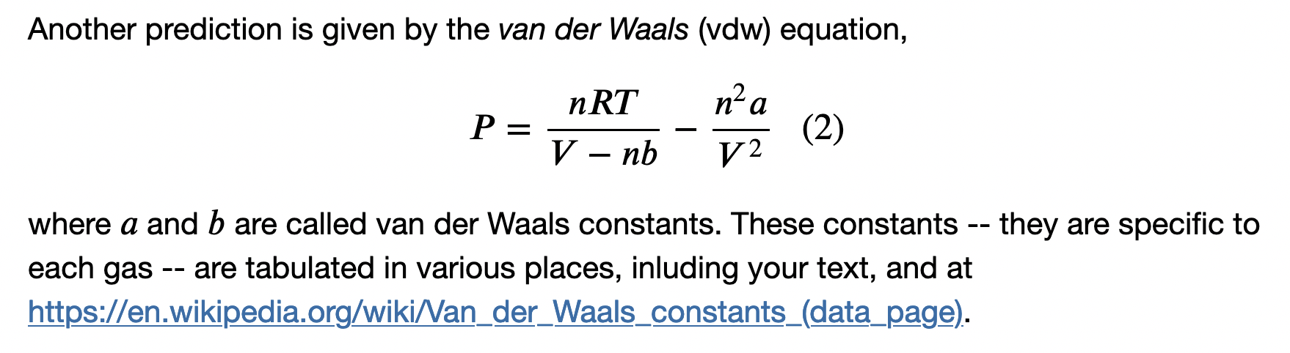

We talked about why we would expect a real gas (here, approximated as a van der Waals gas) might have higher or lower pressure than an ideal gas
Intermolecular forces
When “a” is big, intermolecular attraction (“stickiness”) is significant, and the pressure is smaller than ideal.
When “b” is big, intermolecular repulsion is significant, and the pressure is bigger than ideal.
Attractions => $P_{real}<P_{ideal}$
Repulsions => $P_{real}>P_{ideal}$

Slide 15
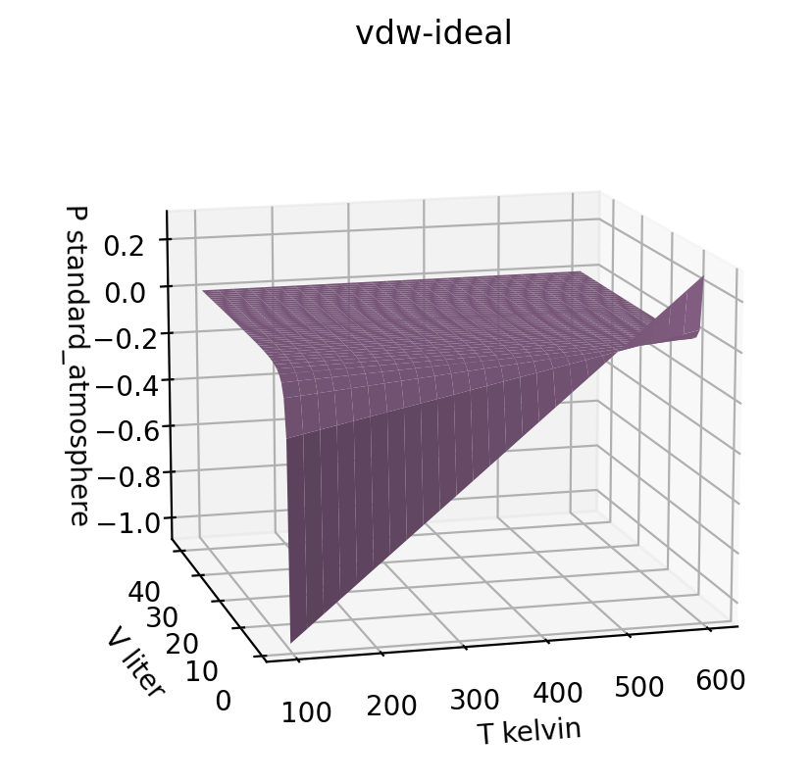
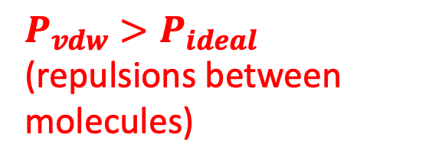
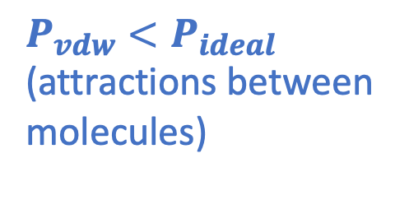
In the CGI, we found that Ar does both, depending on temperature (esp. visible at low volume)
$P_{vdw}>P_{ideal}$ (repulsions between molecules)
$P_{vdw}<P_{ideal}$ (attractions between molecules)

Slide 16
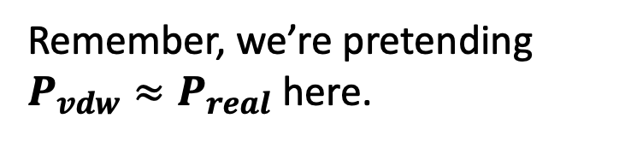
In the CGI, we found that Ar does both, depending on temperature (esp. visible at low volume)
$P_{vdw}>P_{ideal}$ (repulsions between molecules)
$P_{vdw}<P_{ideal}$ (attractions between molecules)
Remember, we’re pretending $P_{vdw}≈P_{real}$ here.

Slide 17
In the CGI, we found that Ar does both, depending on temperature (esp. visible at low volume)
$P_{vdw}>P_{ideal}$ (repulsions between molecules)
$P_{vdw}<P_{ideal}$ (attractions between molecules)
Remember, we’re pretending $P_{vdw}≈P_{real}$ here.
But what causes intermolecular attractions or repulsion in the first place?

Slide 18
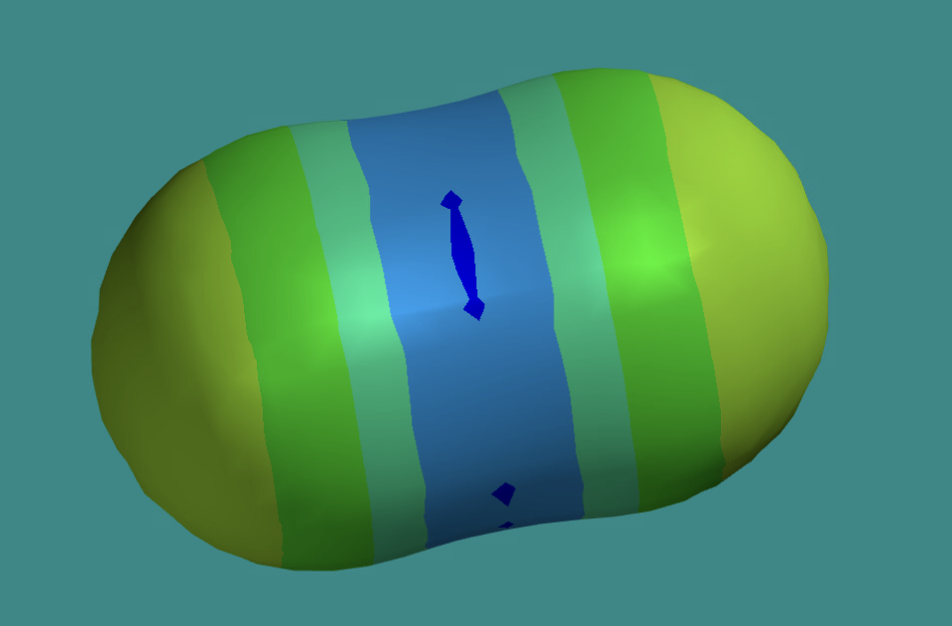
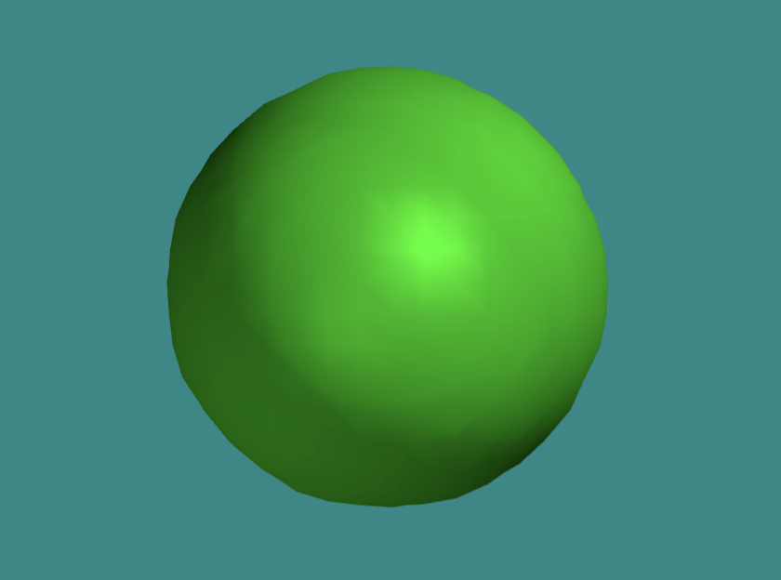
All molecules are slightly sticky
-
-
+
+
-
-

Slide 19
All molecules are slightly sticky
-
-
+
+
-
-
Electrostatic attraction is also possible between two CO₂ molecules when they’re lined up right.

Slide 20
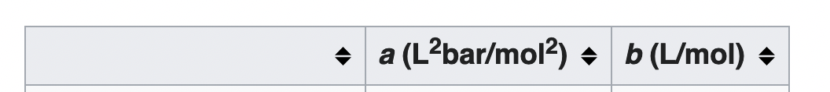
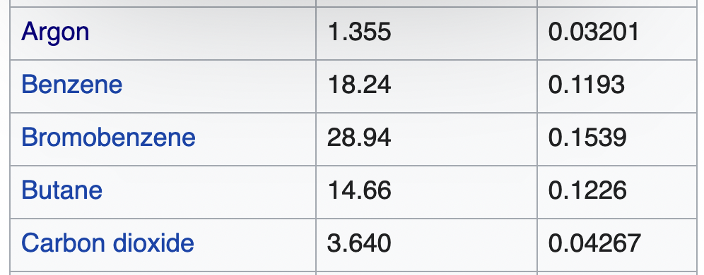
The extra attraction is reflected in a bigger vdw “a” value for CO₂
-
-
+
+
-
-
Electrostatic attraction is also possible between two CO₂ molecules when they’re lined up right.

Slide 21
New idea: vdw “b” is a measure of how big an atom or molecule is ... And CO₂ is a little bigger
-
-
+
+
-
-
Electrostatic attraction is also possible between two CO₂ molecules when they’re lined up right.

Slide 22
In the CGI, we found that Ar does both, depending on temperature (esp. visible at low volume)
$P_{vdw}>P_{ideal}$ (repulsions between molecules)
$P_{vdw}<P_{ideal}$ (attractions between molecules)
The crossover temperature is predicted to be $T_{Boyle}≈\frac{a}{bR}$

Slide 23
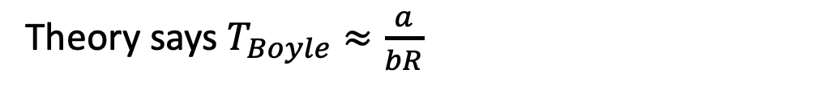

Predicting the Boyle temperature
You calculated $T_{Boyle}$ for Ar to be 509 K.
Ar
Ar gas

Slide 24
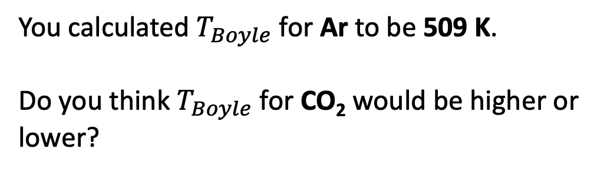
Predicting the Boyle temperature
You calculated $T_{Boyle}$ for Ar to be 509 K.
Do you think $T_{Boyle}$ for CO₂ would be higher or lower?
Ar
Ar gas

Slide 25
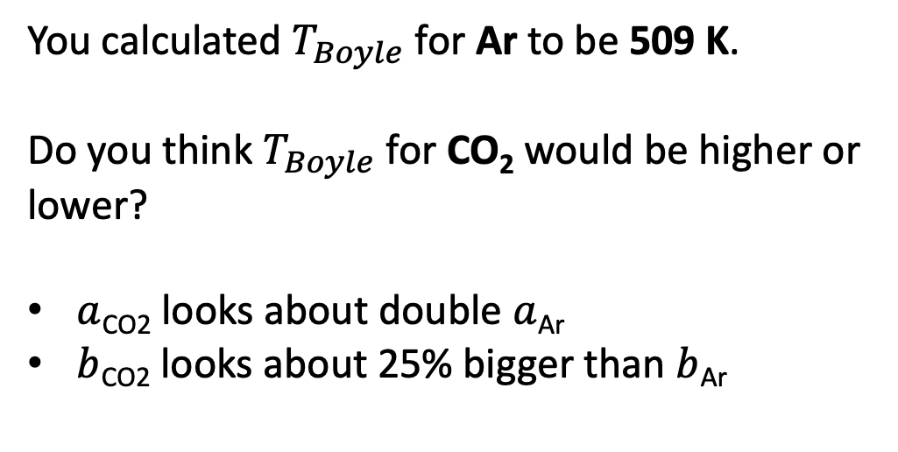
Predicting the Boyle temperature
You calculated $T_{Boyle}$ for Ar to be 509 K.
Do you think $T_{Boyle}$ for CO₂ would be higher or lower?
$a$_{CO2} looks about double $a$_{Ar}
$b$_{CO2} looks about 25% bigger than $b$_{Ar}
Ar
Ar gas

Slide 26
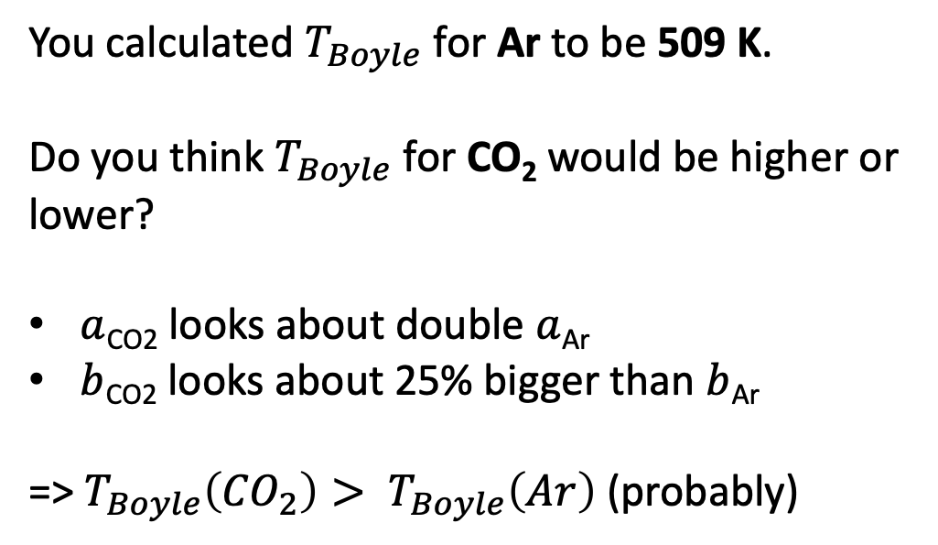
Predicting the Boyle temperature
You calculated $T_{Boyle}$ for Ar to be 509 K.
Do you think $T_{Boyle}$ for CO₂ would be higher or lower?
$a$_{CO2} looks about double $a$_{Ar}
$b$_{CO2} looks about 25% bigger than $b$_{Ar}
=> $T_{Boyle}\left({CO}_{2}\right)> T_{Boyle}\left(Ar\right)$ (probably)
Ar
Ar gas

Slide 27
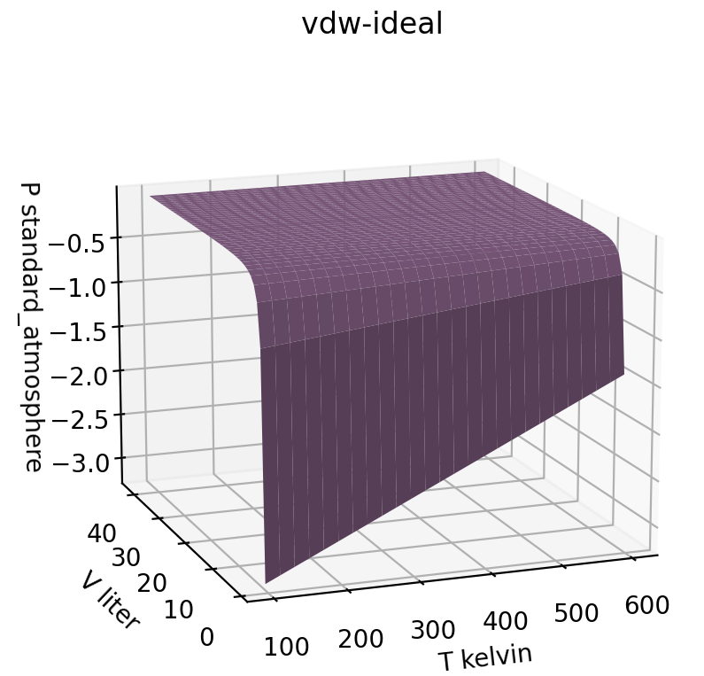
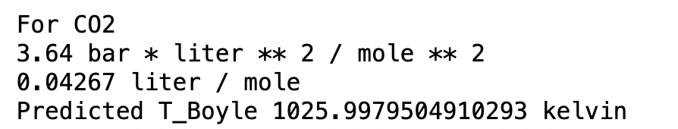
Predicting the Boyle temperature
Ar gas
CO₂ gas
> 1000 K

Slide 28
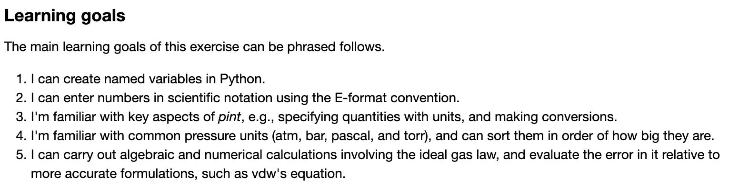
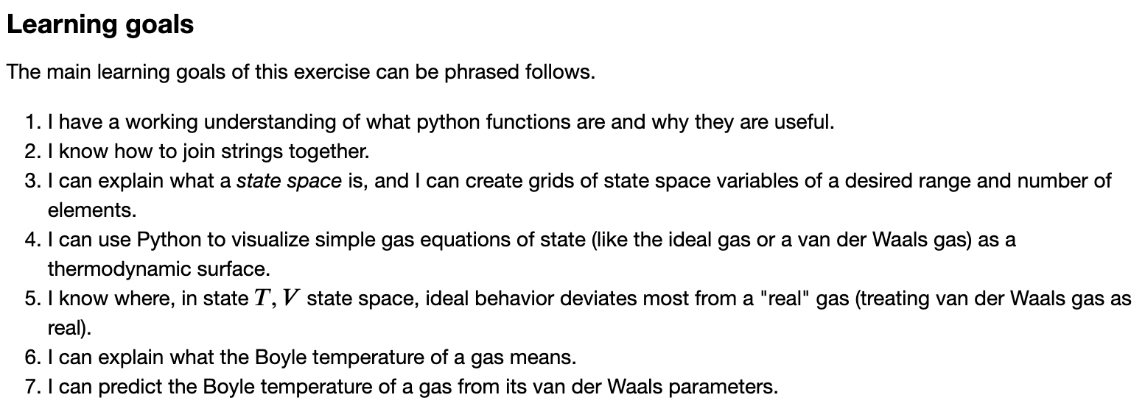
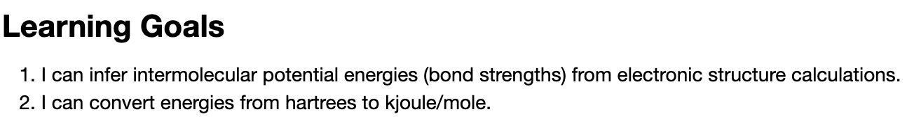
Learning goals

Slide 29
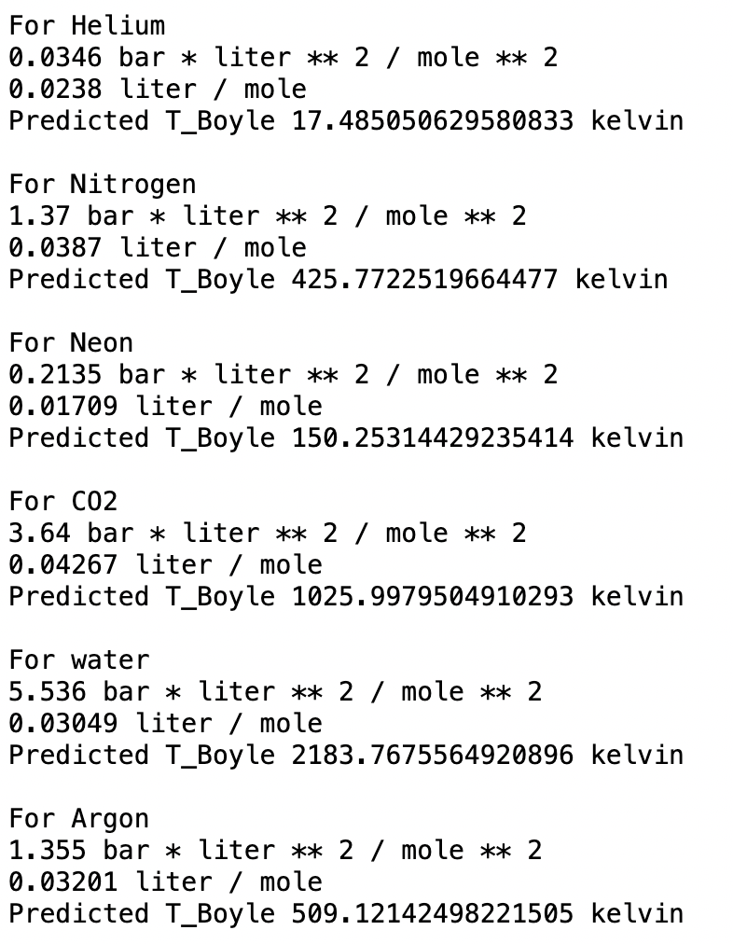
Predicting the Boyle temperature

Slide 30
Week 1 (sample interview question)
Pressure units
Rank these in order of the biggest unit to the smallest unit (like, 1 hour > 1 minute):
bar, pascal, torr, atm

Slide 31
Week 1 (sample interview question)
The E-format convention
Write 1.38 x 10⁻²³ using the E-format convention

Slide 32
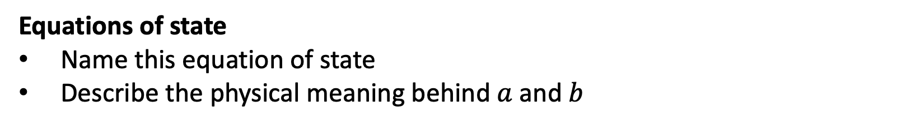
Week 1 (sample interview question)
Equations of state
Name this equation of state
Describe the physical meaning behind $a$ and $b$

Slide 33
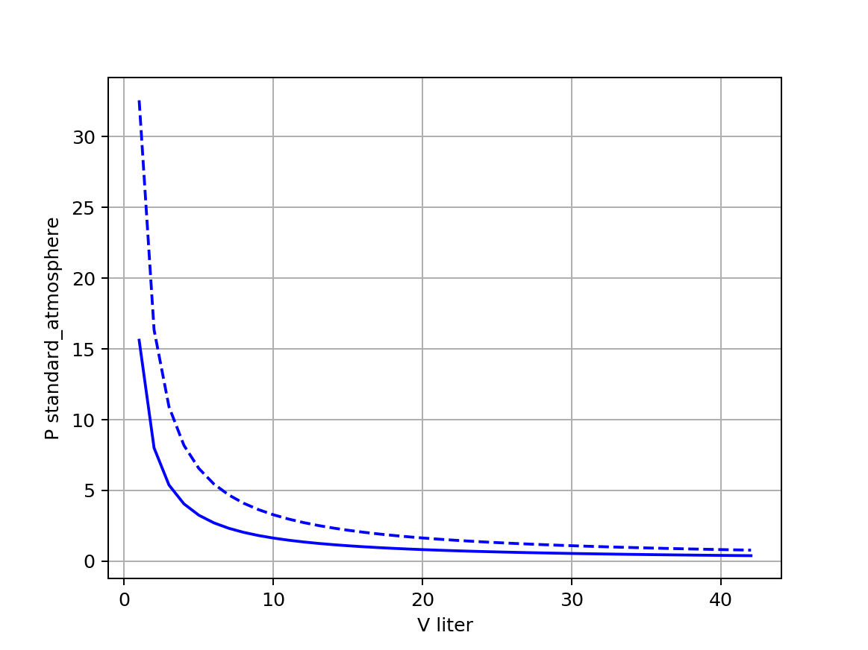
Week 1 (sample interview question)
Boyle isotherms
Which line is the hotter isotherm? What’s your reasoning?

